Slide 1
Monthly trends on smoking in Wales from the Smoking Toolkit Study
Robert West, Loren Kock, Dimitra Kale, Jamie Brown

Slide 2
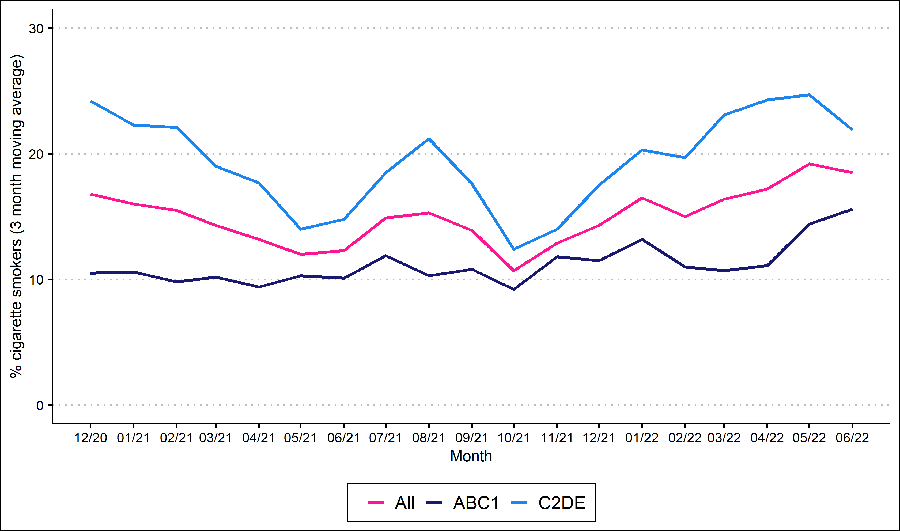
Prevalence of cigarette smoking by social grade

Slide 3
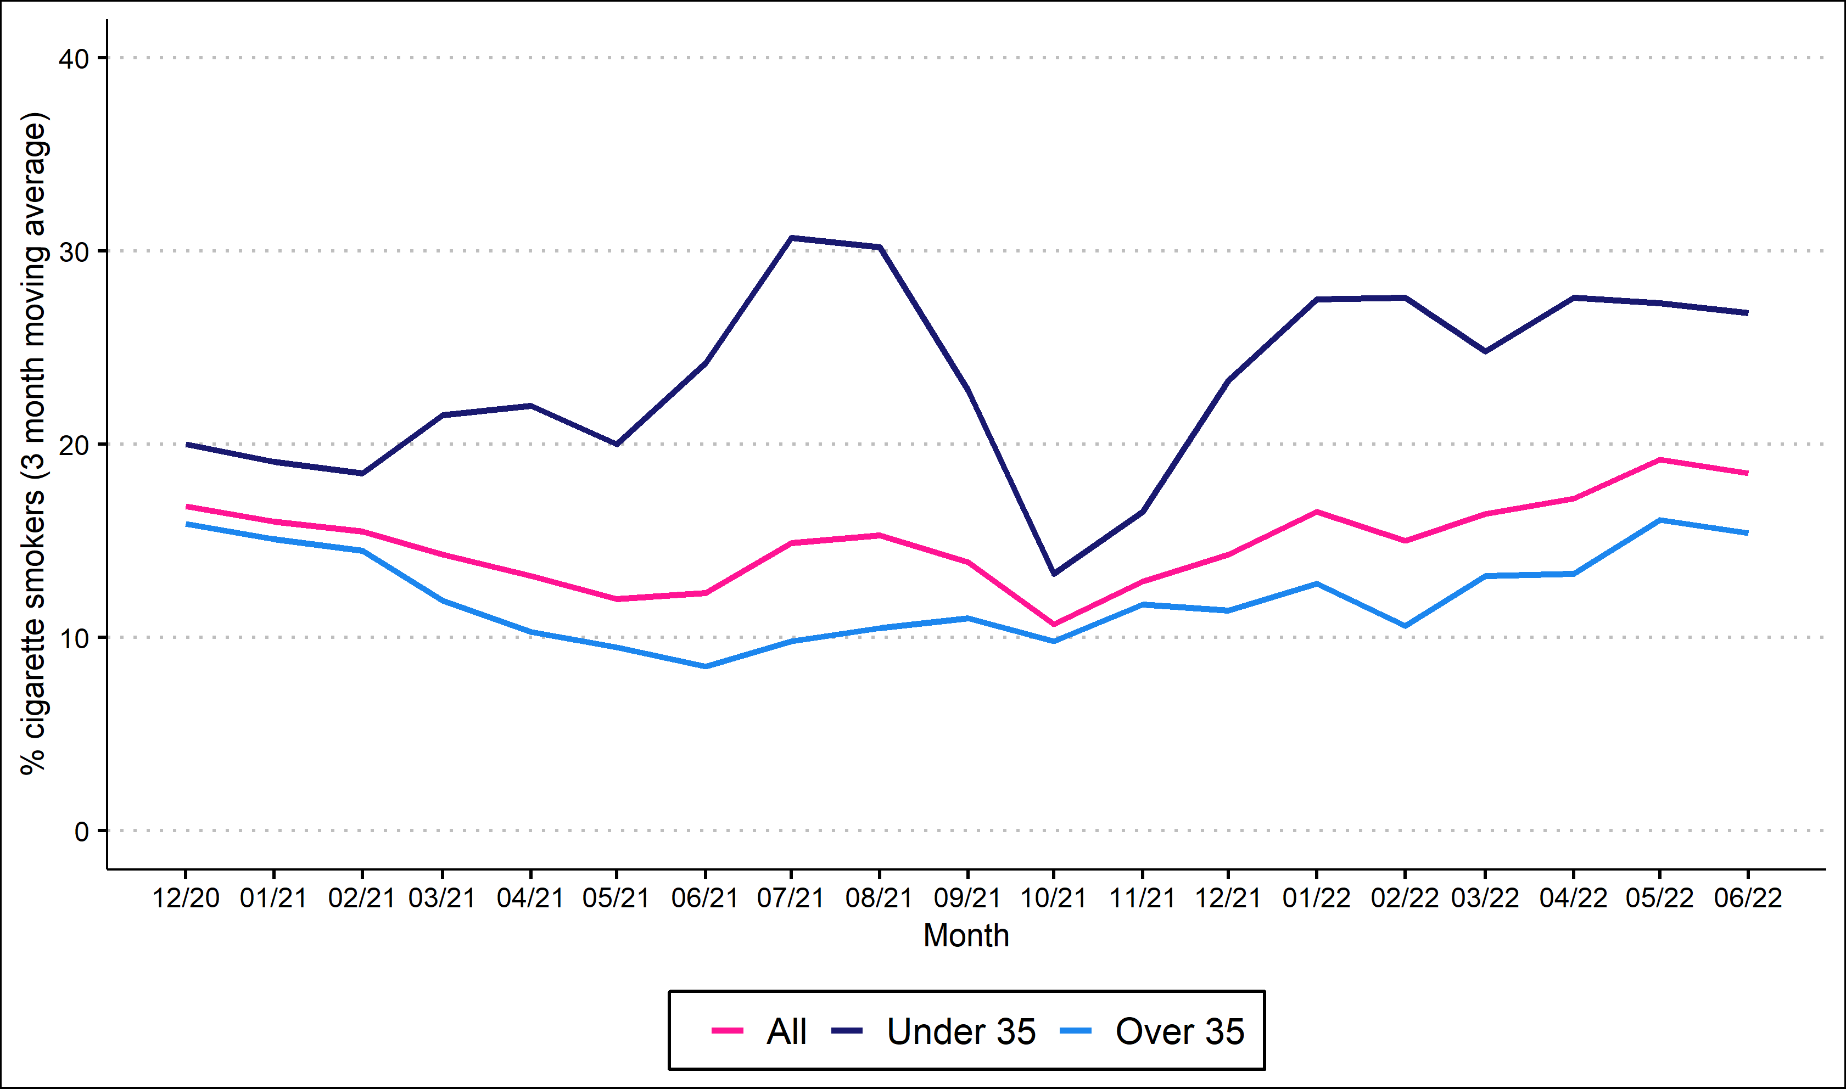
Prevalence of cigarette smoking by age

Slide 4
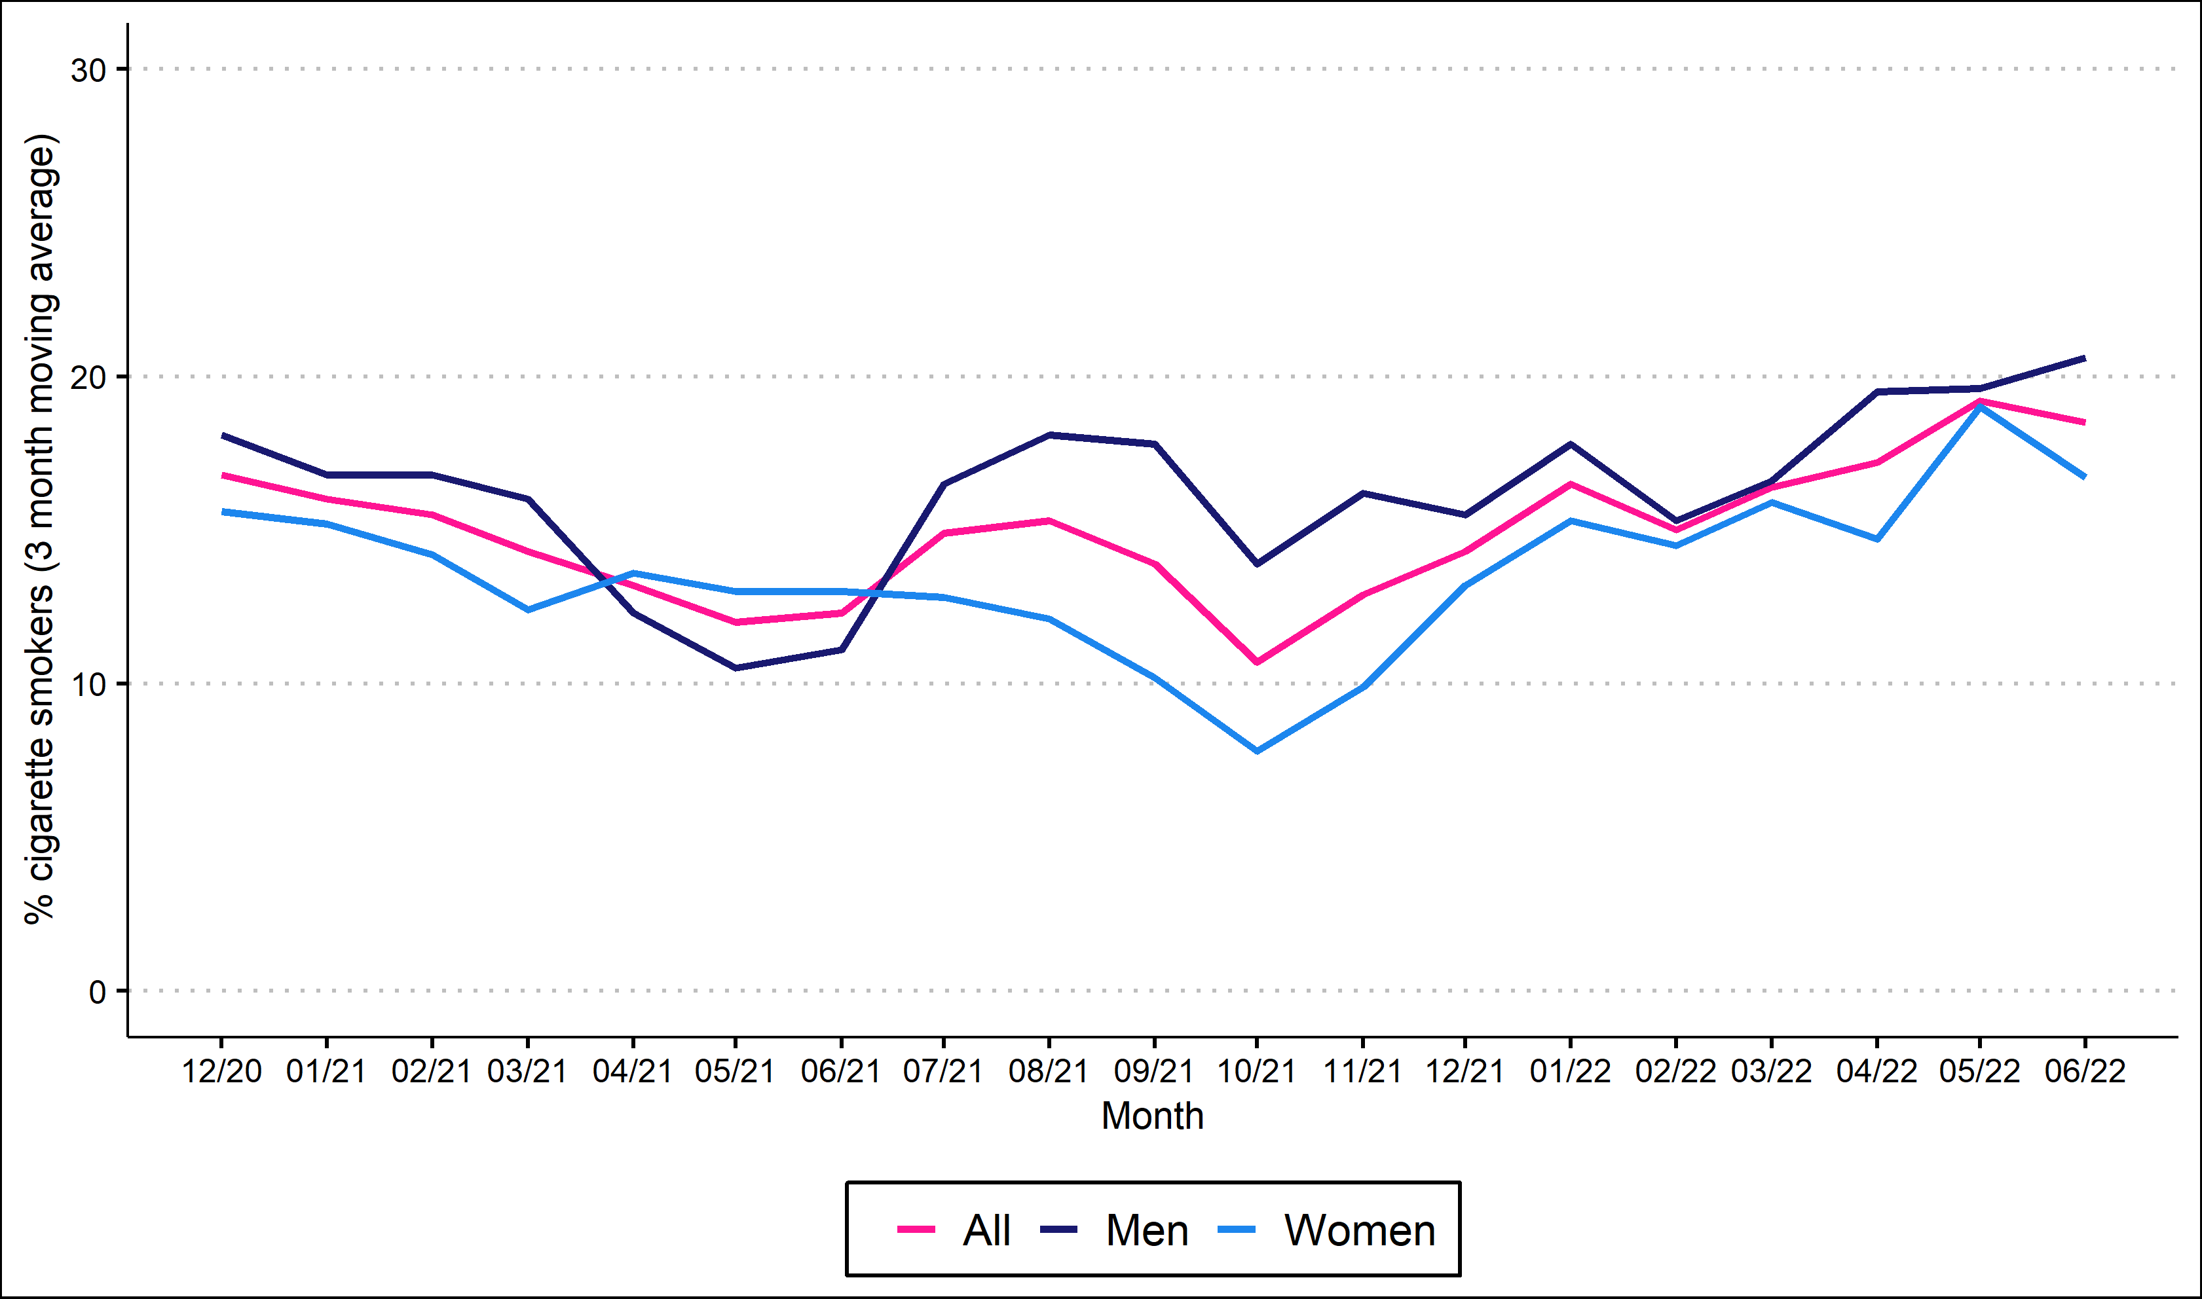
Prevalence of cigarette smoking by sex

Slide 5
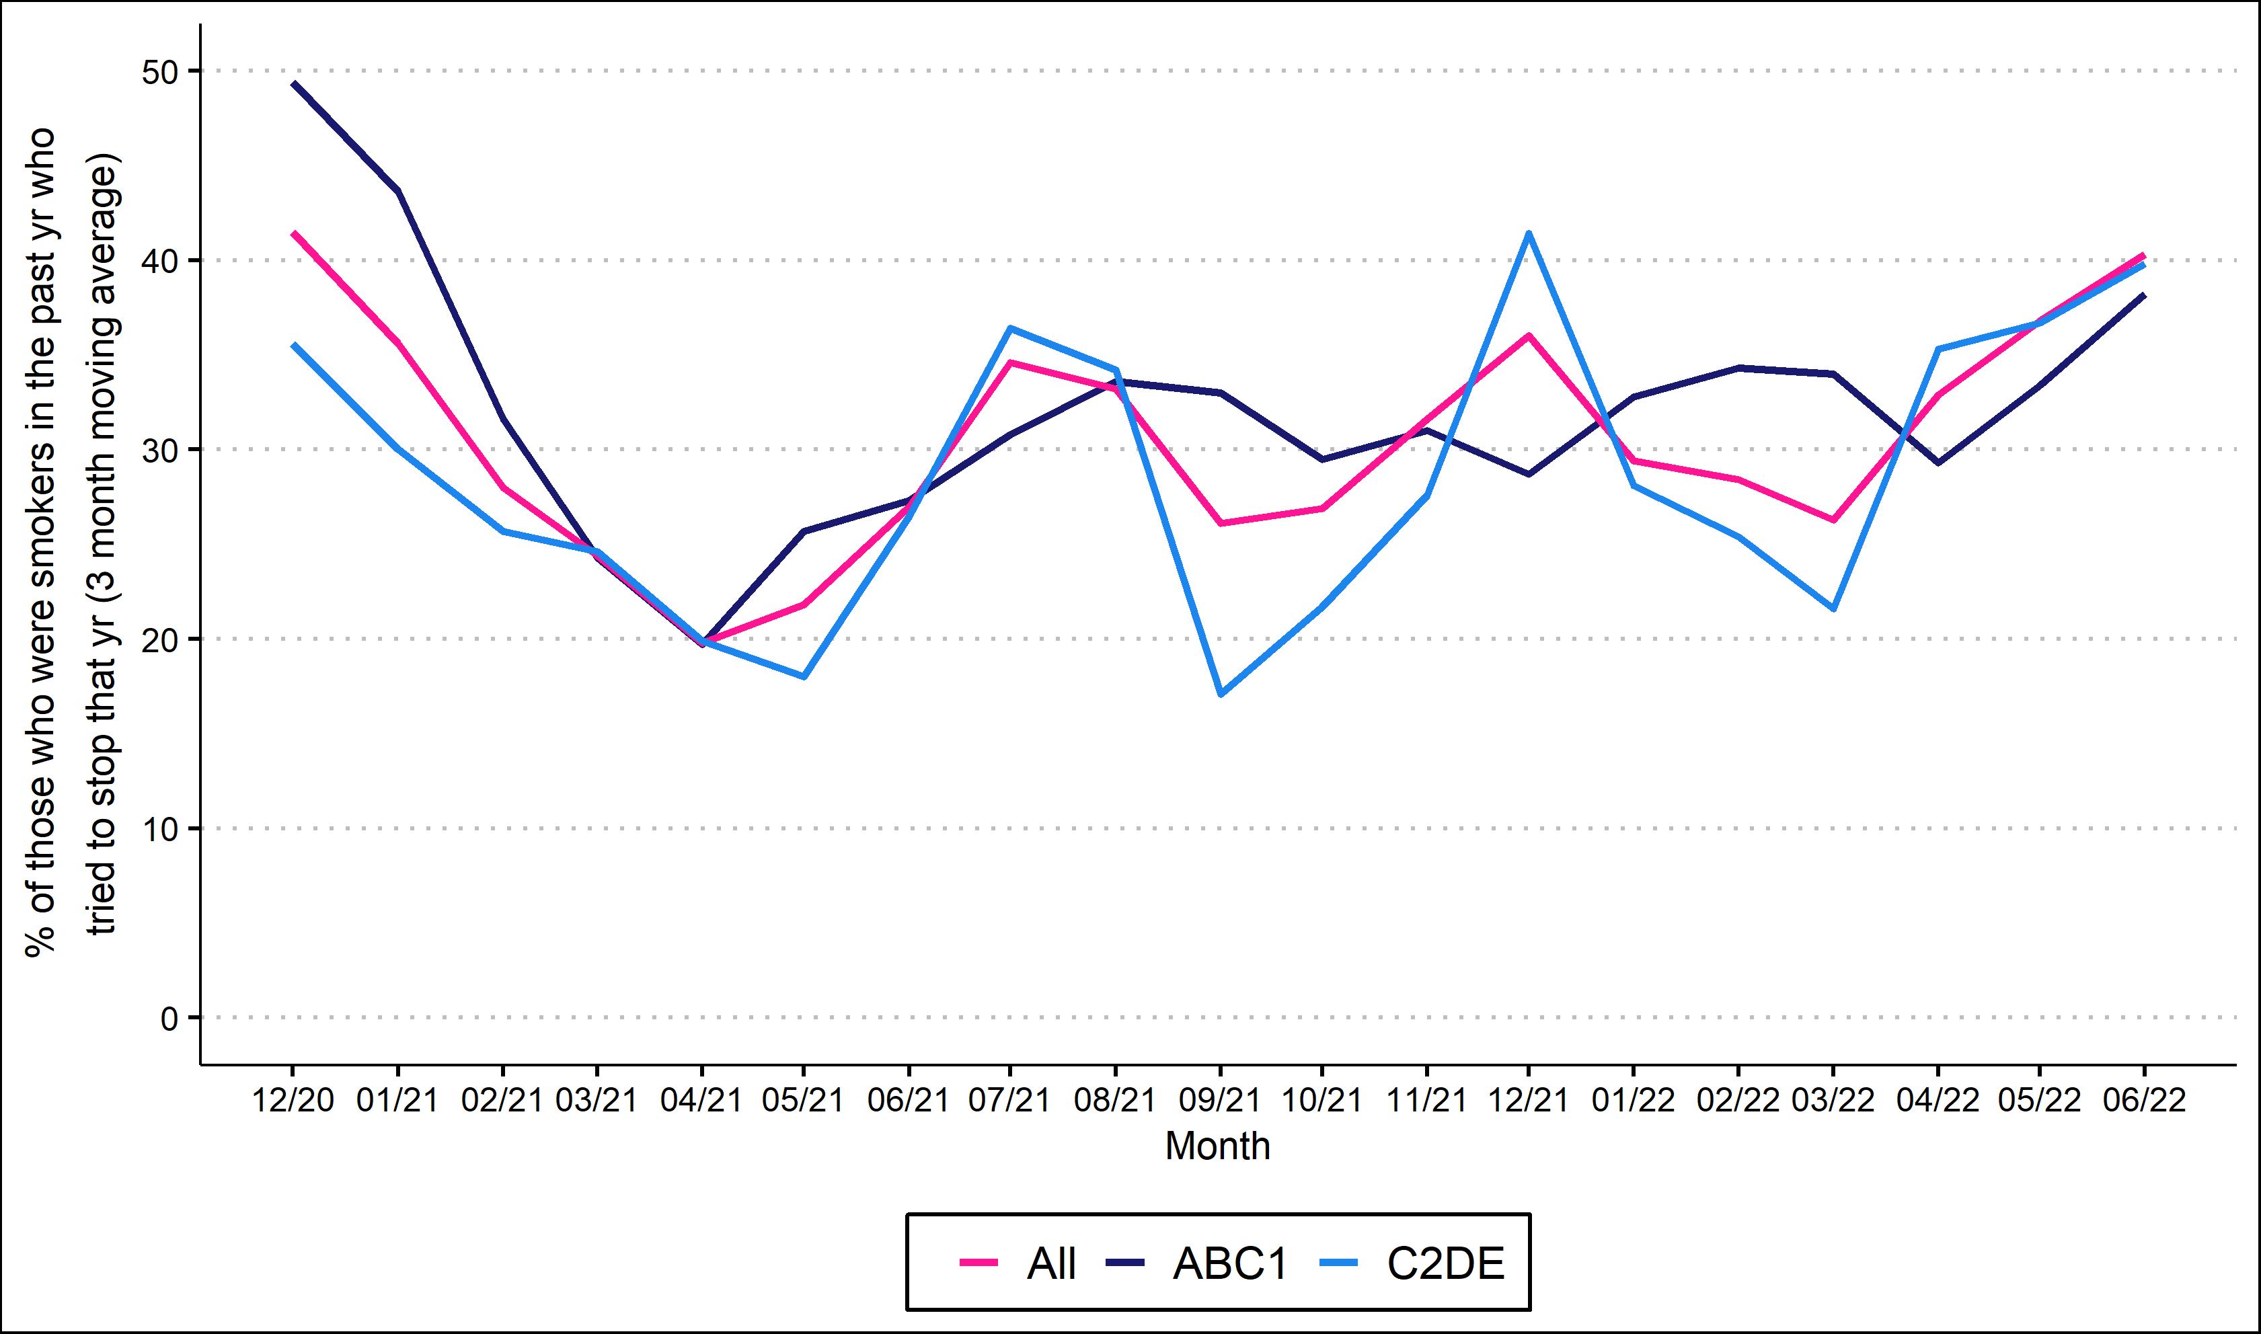
Attempts to stop by social grade

Slide 6
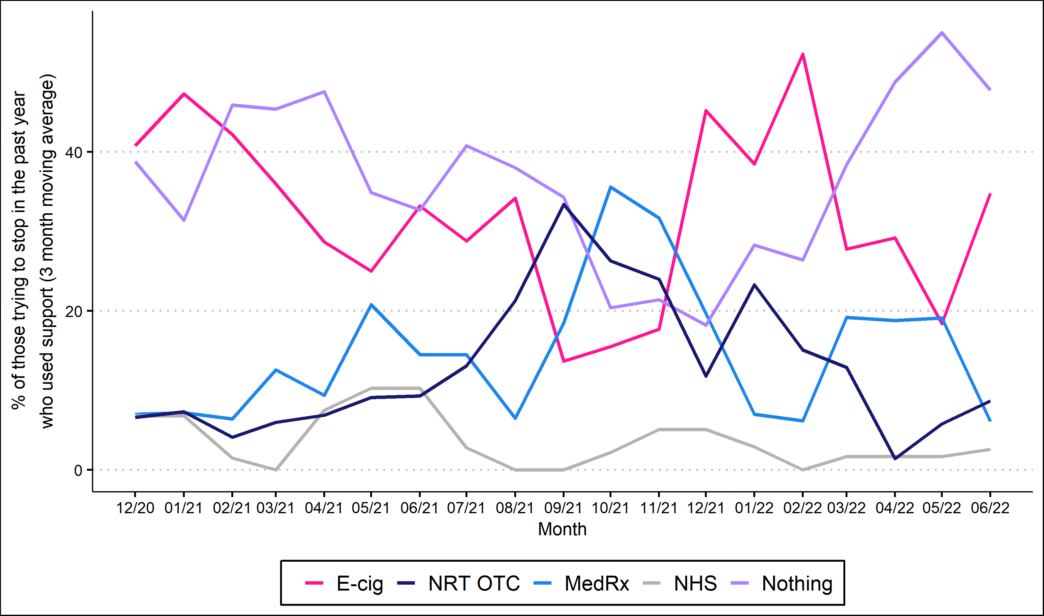
Support used in quit attempts

Slide 7
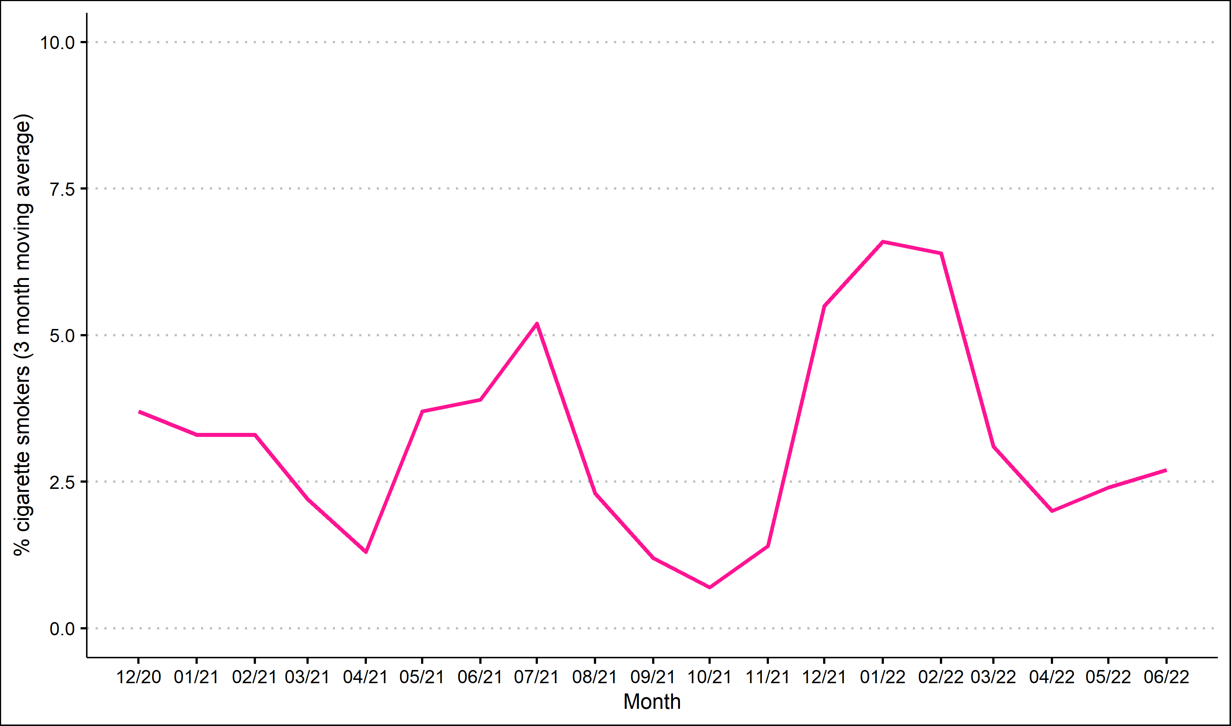
GP-triggered quit attempts

Slide 8
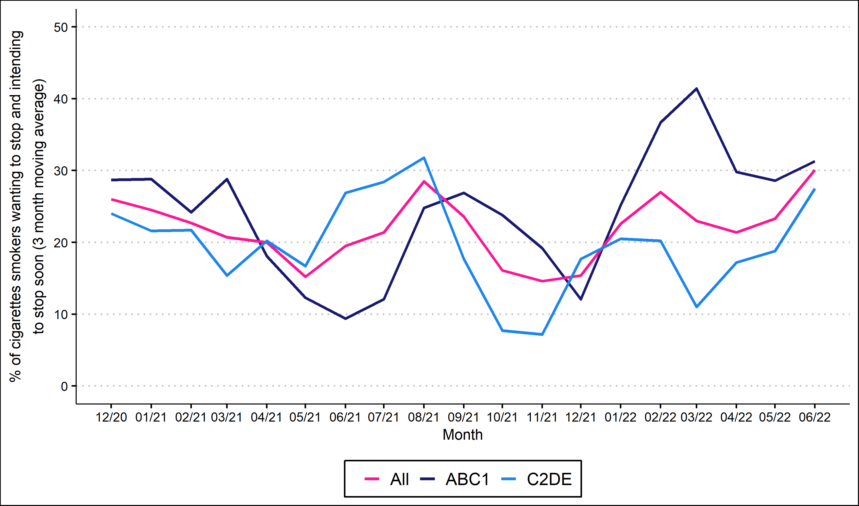
Motivation to quit

Slide 9
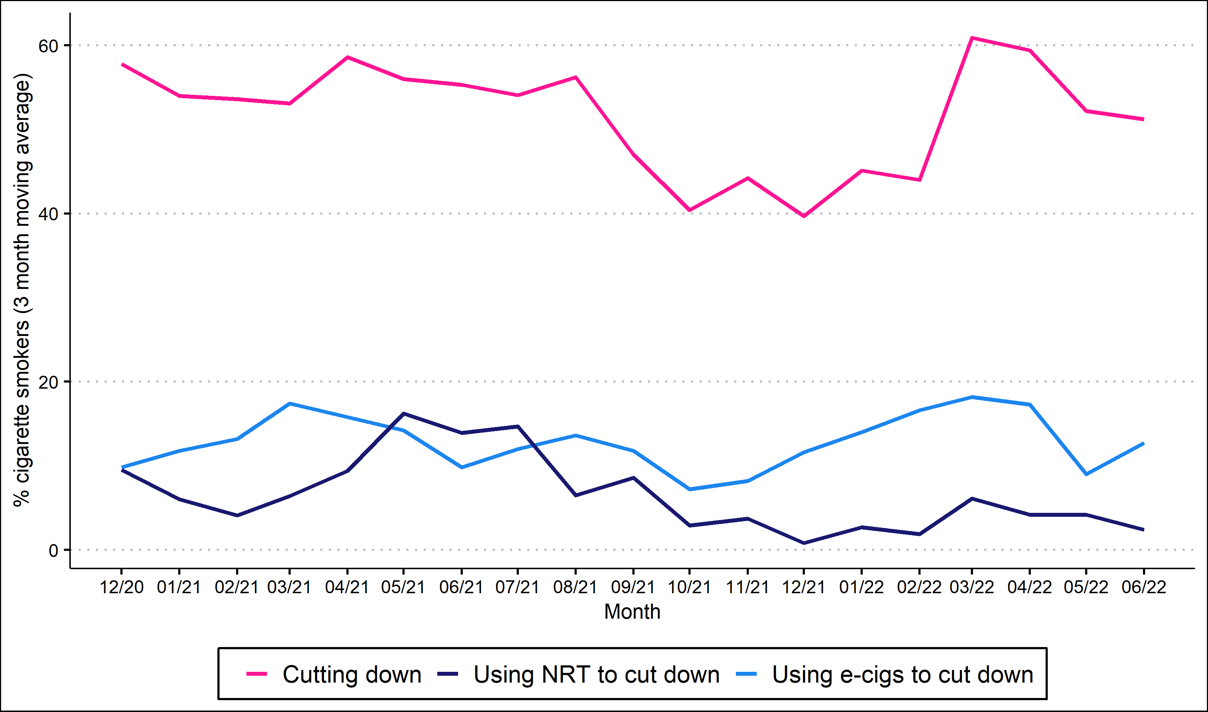
Harm reduction

Slide 10
Methods
Data collected during monthly household survey
Each month involves a new representative sample of 250-300 adults (18 and over)
Due to pandemic, surveys are conducted by telephone (rather than face-to-face) and among adults aged 18 and over between April 2020-December 2021.
Kock, et al., 2021. Protocol for expansion of an existing national monthly survey of smoking behaviour and alcohol use in England to Scotland and Wales: The Smoking and Alcohol Toolkit Study. Wellcome Open Research. 6:67
For more information (including the data underlying each chart) visit www.smokinginwales.info

